Slide 1
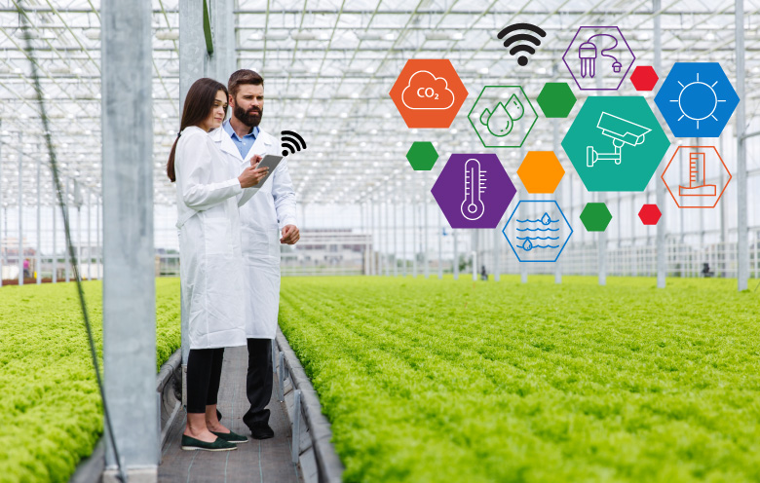
Implementation of Greenhouse Environment

Slide 2
Group Members:
Madhuli Pangavhane (B-67) Sumit Yadav (C-69)
Manish Zine (C-70)
Project Guide :
Prof. Praveen Pol

Slide 3
Content
Problem Statement
Introduction
What is greenhouse environment?
Objective
Literature review
Components
Block diagram
Project image
Advantages
Applications
Learning Outcomes
Conclusion
Reference

Slide 4
Problem Statement
Greenhouse systems are to a great degree important in the sense that they provide controlled climatic conditions around plants for optimum plant growth.
To achieve this, a microcontroller based circuit is used to monitor and control the set parameters of the environment.

Slide 5
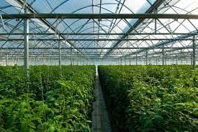
Introduction
Greenhouse technology is the technique of providing favourable environmental conditions for plants. Greenhouse monitoring and controlling projects is used to measure the various parameters like temperature, humidity, light, water content level, moisture, etc. and to display them on LED.

Slide 6
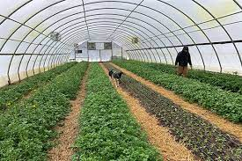
What is greenhouse environment?
A greenhouse is a structure, usually made of glass, in which temperature and humidity can be controlled for the cultivation or protection of plants. A greenhouse is designed to trap heat from the sun's rays inside and acts to keep the plants inside warm, even when it is cold outside.

Slide 7

Objective
The aim of this research is to deign and implement a monitor and control system for a greenhouse environment.
The objectives include:
To read greenhouse environment parameter(like Soil moister, temperature and humidity) using sensor.
To control environmental parameters based on read parameter with a microcontroller.
To display environmental parameter using a LCD.

Slide 8
Literature Review
AUTHOR | TTITLE | AIM | RESULT
Daniela Attalia ET AL.[2] | Automated Greenhouse(temperature and soil moisture control) | To analyze the possibility of a greenhouse temperature being maintained in a desired range for optimum crop yield, investigate the reliability of the watering system. | Watering system wasn’t function but the temperature control system was okay.

Slide 9
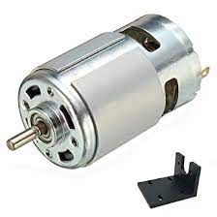
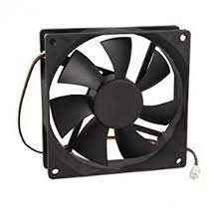
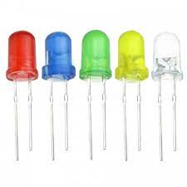
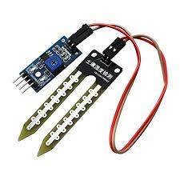
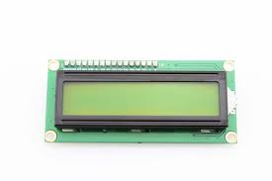
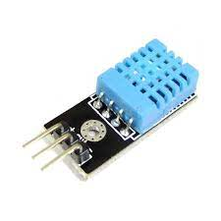
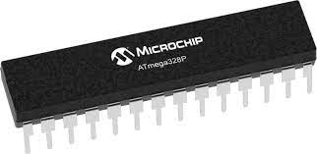
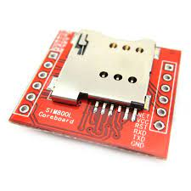
Components
GSM800L
Microcontroller 328p
DHT11(Temperature and humidity sensor)
Moisture sensor
12 V Fan
DC motor
LED
LCD

Slide 10
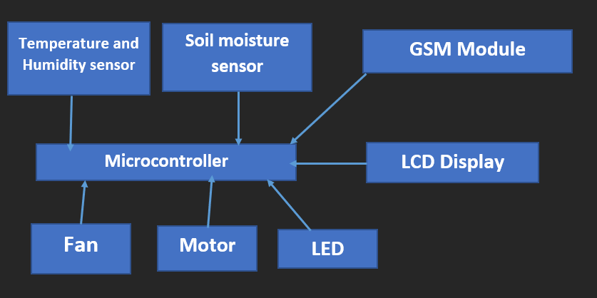
Block diagram

Slide 11
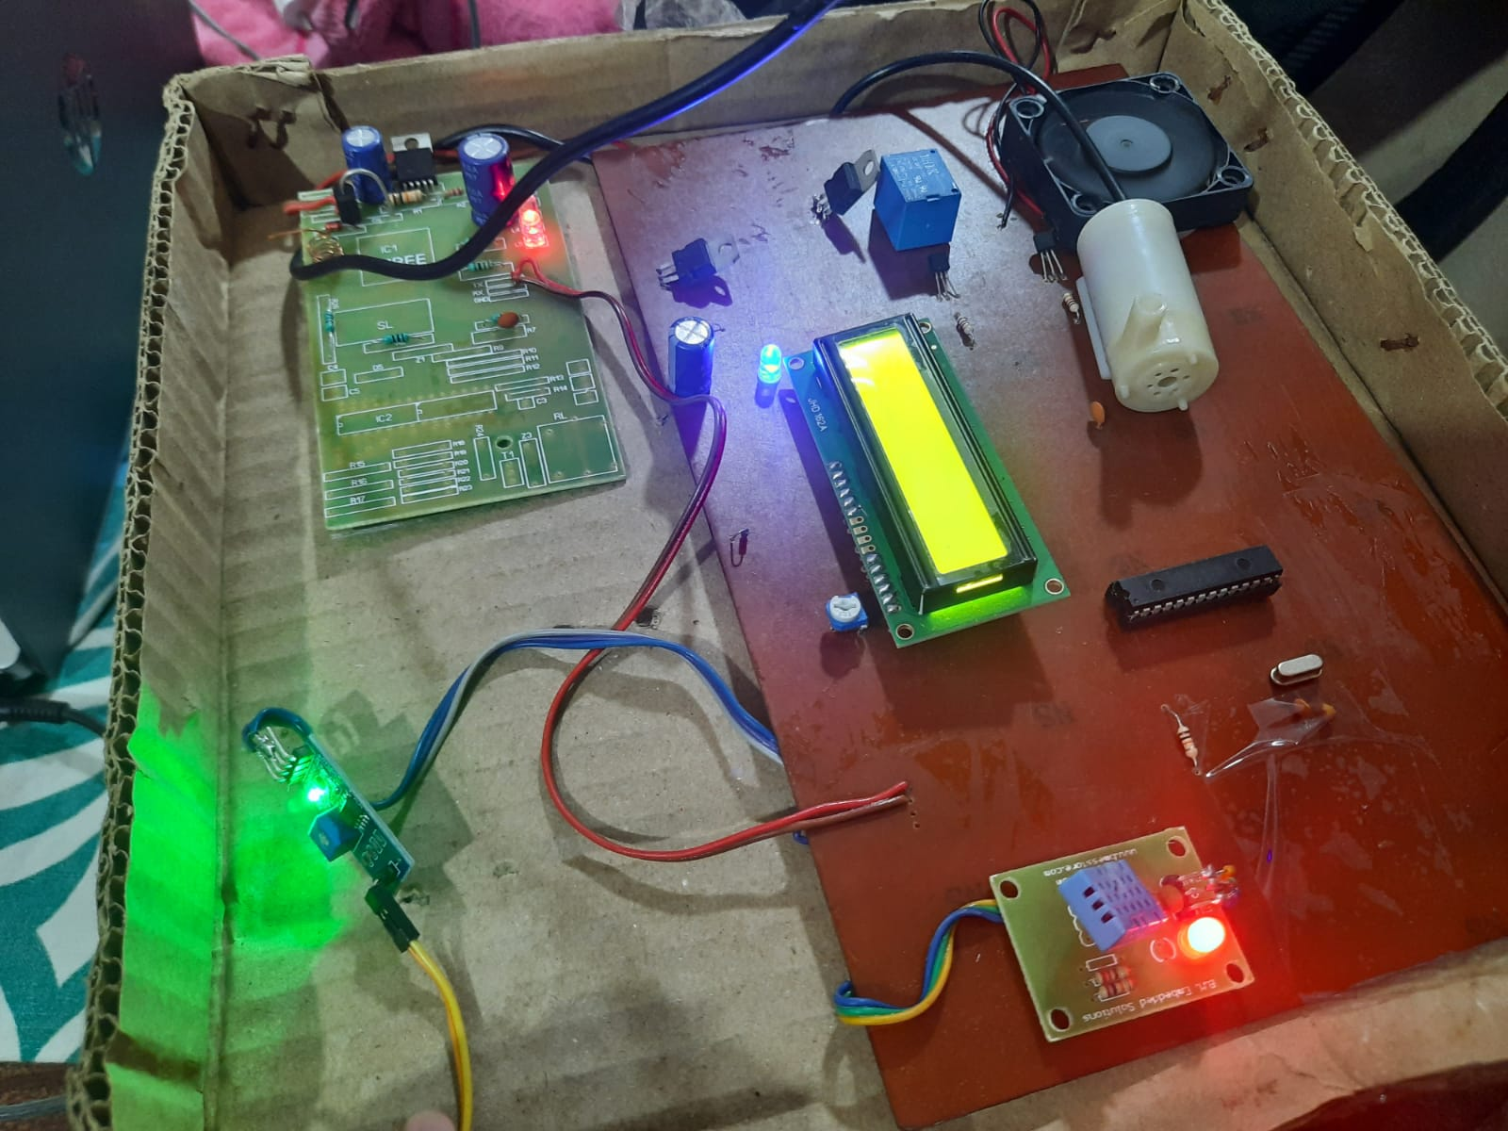
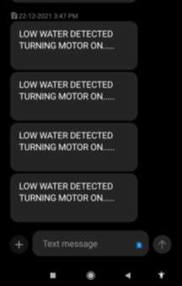
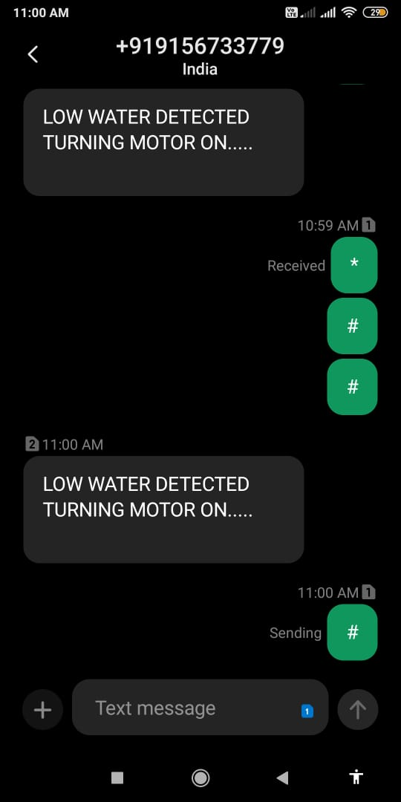
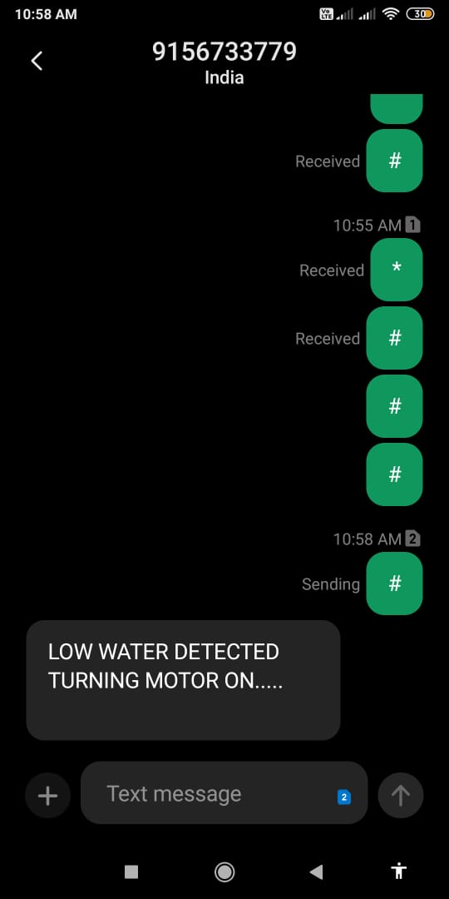
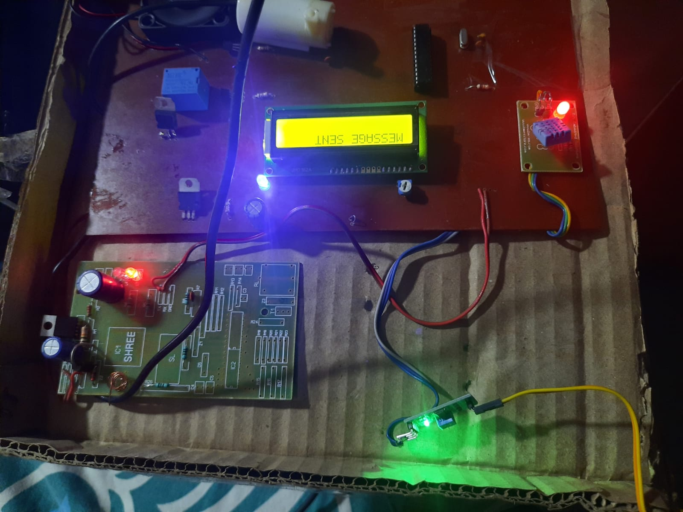
Project Image

Slide 12
Advantages
Good production of food.
Off – season crops.
Increment in fertility.
Easy to use.

Slide 13
Applications
This project has a good application in rural areas for agriculture sector.
It is use to control and monitor the temperature at home like in bedroom, kitchen.
It can also be used in agriculture farm and garden.

Slide 14
Learning Outcomes
Working of Temperature , moisture and humidity Sensors.
We have learned controlling elements like fan , bulb and to represent pump of water we used DC motor.
Understanding of GSM module and Arduino Board.

Slide 15
Conclusion
This design which is environmental, controlling and monitoring the parameters inside the greenhouse. Is implemented on Microcontroller 328p. From this project we survey the atmospheric condition (weather condition) and inspection the crops. From this farmer’s saves time, money, man power.

Slide 16
Reference
https://www.researchgate.net/publication/352157563_GREENHOUSE_ENVIRONMENTAL_MONITORING_AND_CONTROLLING_SYSTEM
http://citeseerx.ist.psu.edu/viewdoc/download?doi=10.1.1.640.2774&rep=rep1&type=pdf
https://ieeexplore.ieee.org/document/9236693

